Slide 1
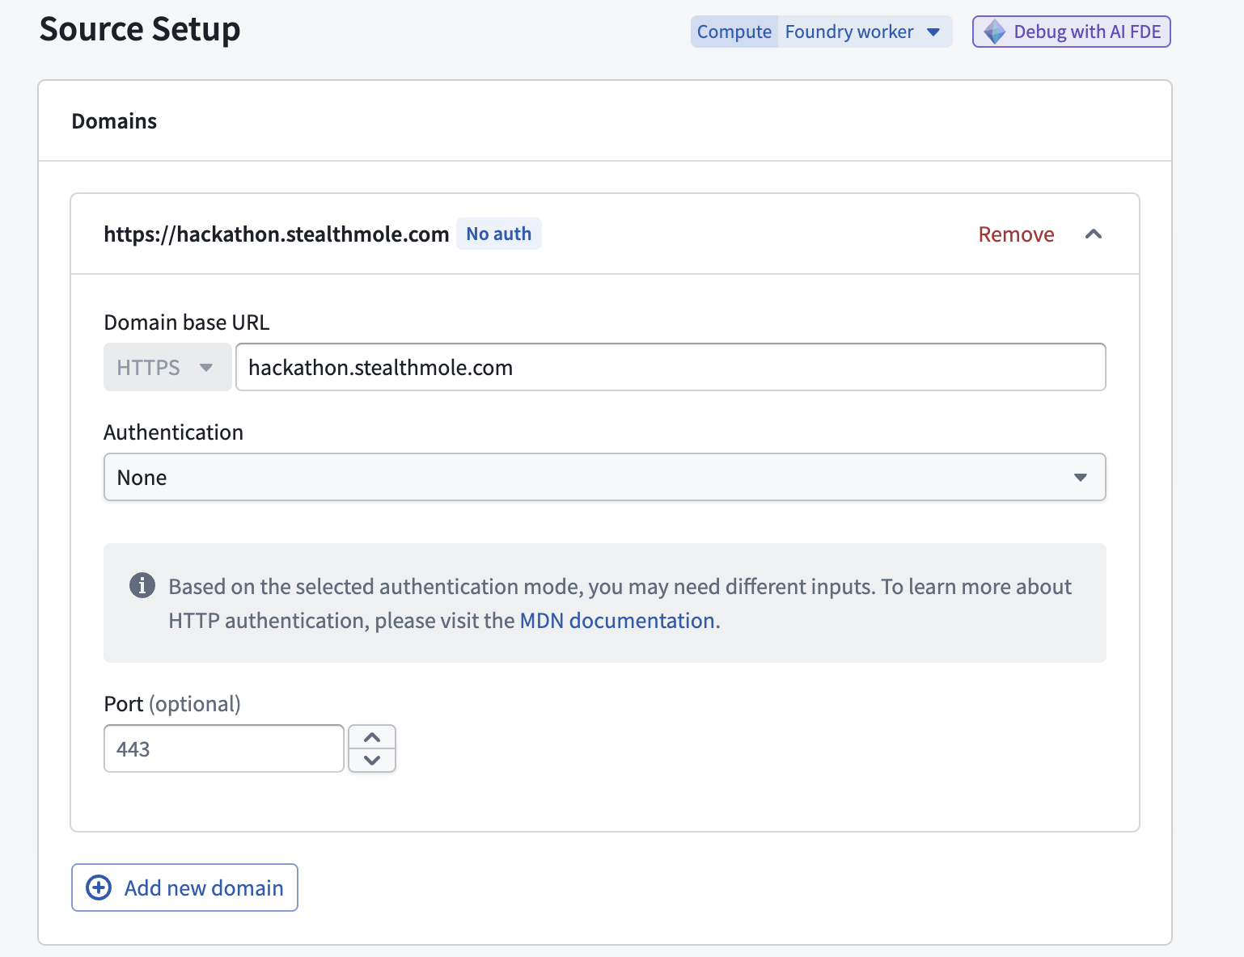
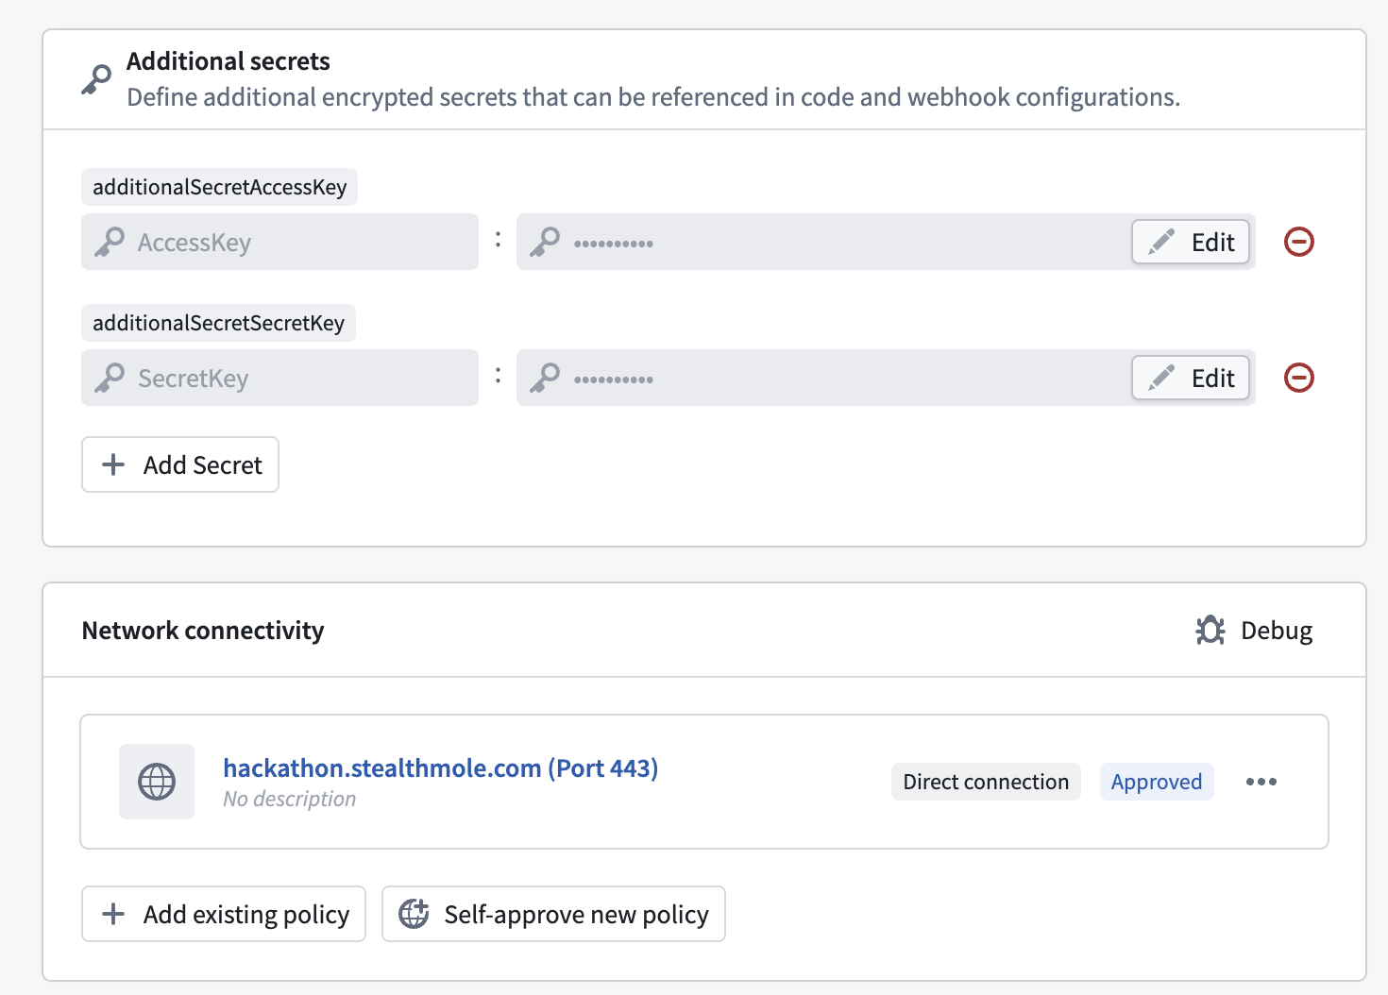
01
Data connection

Slide 2
01
helpers.py
"""
StealthMole API Helper Functions
- JWT 생성
- API 호출 공통 로직
"""
import datetime
import uuid
import jwt
import logging
logger = logging.getLogger(__name__)
# ─────────────────────────────────────────
# 공통 상수 (환경 변경 시 여기만 수정)
# ─────────────────────────────────────────
SOURCE_RID = "ri.magritte..source.f90a99cb-e8e0-4e02-8569-50a2ad157ae9"
RAW_PATH = "/ypark-44c850/Track#2/dataset/raw"
OUTPUT_PATH = "/ypark-44c850/Track#2/dataset/raw/checker"
# 다중 도메인 지원
TARGET_DOMAINS = ["linkedin.com", "adobe.com", "yahoo.com"]
DEFAULT_LIMIT = 3
def generate_jwt(access_key, secret_key):
"""StealthMole JWT 토큰 생성 (매 요청마다 새로 생성)"""
payload = {
"access_key": access_key,
"nonce": str(uuid.uuid4()),
"iat": int(datetime.datetime.now(datetime.timezone.utc).timestamp()),
}
return jwt.encode(payload, secret_key, algorithm="HS256")
def get_auth_headers(access_key, secret_key):
"""인증 헤더 생성"""
token = generate_jwt(access_key, secret_key)
return {"Authorization": "Bearer " + token}
def safe_api_call(client, url, headers, timeout=30):
"""API 호출 + 에러 핸들링 + 로깅"""
logger.info("Calling API: %s", url)
try:
response = client.get(url, headers=headers, timeout=timeout)
logger.info("Status: %s, Size: %s bytes", response.status_code, len(response.text))
if response.status_code in (200, 202):
return response.json(), None
else:
error_msg = "HTTP {}: {}".format(response.status_code, response.text[:500])
logger.error(error_msg)
return None, error_msg
except Exception as e:
error_msg = "Exception: {}".format(str(e))
logger.error(error_msg)
return None, error_msg
def get_stealthmole_connection(source):
"""Data Connection Source에서 client, base_url, access_key, secret_key 추출"""
client = source.get_https_connection().get_client()
base_url = source.get_https_connection().url
access_key = source.get_secret("additionalSecretAccessKey")
secret_key = source.get_secret("additionalSecretSecretKey")
return client, base_url, access_key, secret_key

Slide 3
01
checkers.py
import pandas as pd
import logging
from transforms.api import transform_pandas, Output
from transforms.external.systems import external_systems, Source
from myproject.datasets.helpers import (
SOURCE_RID,
OUTPUT_PATH,
get_auth_headers,
get_stealthmole_connection,
)
logger = logging.getLogger(__name__)
@external_systems(stealthmole=Source(SOURCE_RID))
@transform_pandas(Output(OUTPUT_PATH))
def fetch_stealthmole(stealthmole):
client, base_url, access_key, secret_key = get_stealthmole_connection(stealthmole)
headers = get_auth_headers(access_key, secret_key)
response = client.get(
base_url + "/user/quotas",
headers=headers,
timeout=30,
)
logger.info("Status code: %s", response.status_code)
logger.info("Response: %s", response.text)
if response.status_code == 200:
data = response.json()
rows = [{"service": s, "allowed": i.get("allowed"), "used": i.get("used")} for s, i in data.items()]
return pd.DataFrame(rows)
else:
return pd.DataFrame(
[
{
"status": response.status_code,
"error": response.text,
"access_key_length": len(access_key),
"secret_key_length": len(secret_key),
}
]
)

Slide 4
01
raw_transform.py
"""
StealthMole Raw Data Ingestion - Multi Domain
- 9개 API 서비스에서 데이터를 수집하여 Raw Dataset에 저장
- 다중 도메인 지원 (linkedin.com, adobe.com, yahoo.com)
"""
import datetime
import json
import pandas as pd
import logging
from transforms.api import transform_pandas, Input, Output, lightweight
from transforms.external.systems import external_systems, Source
from myproject.datasets.helpers import (
SOURCE_RID,
RAW_PATH,
TARGET_DOMAINS,
DEFAULT_LIMIT,
get_auth_headers,
safe_api_call,
get_stealthmole_connection,
)
logger = logging.getLogger(__name__)
def _fetch_dt_tt(source, service_code, endpoint_template):
"""TT 로직 - 다중 도메인"""
client, base_url, ak, sk = get_stealthmole_connection(source)
now = datetime.datetime.now(datetime.timezone.utc).isoformat()
all_rows = []
for domain in TARGET_DOMAINS:
headers = get_auth_headers(ak, sk)
url = endpoint_template.format(base_url=base_url, domain=domain, limit=DEFAULT_LIMIT)
data, error = safe_api_call(client, url, headers)
if error:
all_rows.append(
{
"query_domain": domain,
"fetched_at": now,
"service": service_code,
"section": "error",
"total_count": 0,
"raw_json": json.dumps({"error": error}),
}
)
continue
if isinstance(data, dict):
for section_name, section_data in data.items():
if isinstance(section_data, dict) and "data" in section_data:
for item in section_data["data"]:
all_rows.append(
{
"query_domain": domain,
"fetched_at": now,
"service": service_code,
"section": section_name,
"total_count": section_data.get("totalCount", 0),
"raw_json": json.dumps(item, ensure_ascii=False, default=str),
}
)
if not section_data["data"]:
all_rows.append(
{
"query_domain": domain,
"fetched_at": now,
"service": service_code,
"section": section_name,
"total_count": section_data.get("totalCount", 0),
"raw_json": "{}",
}
)
if not all_rows:
all_rows.append(
{
"query_domain": "none",
"fetched_at": now,
"service": service_code,
"section": "empty",
"total_count": 0,
"raw_json": "{}",
}
)
return pd.DataFrame(all_rows)
def _fetch_flat(source, service_code, endpoint_template):
"""CL/CDS/CB/RM/GM/LM 공통 로직 - 다중 도메인"""
client, base_url, ak, sk = get_stealthmole_connection(source)
now = datetime.datetime.now(datetime.timezone.utc).isoformat()
all_rows = []
for domain in TARGET_DOMAINS:
headers = get_auth_headers(ak, sk)
url = endpoint_template.format(base_url=base_url, domain=domain, limit=DEFAULT_LIMIT)
data, error = safe_api_call(client, url, headers)
if error:
all_rows.append(
{
"query_domain": domain,
"fetched_at": now,
"service": service_code,
"raw_json": json.dumps({"error": error}),
}
)
continue
results = data if isinstance(data, list) else data.get("data", data.get("results", []))
if isinstance(results, dict):
results = [results]
for item in results:
all_rows.append(
{
"query_domain": domain,
"fetched_at": now,
"service": service_code,
"raw_json": json.dumps(item, ensure_ascii=False, default=str),
}
)
if not results:
all_rows.append({"query_domain": domain, "fetched_at": now, "service": service_code, "raw_json": "{}"})
if not all_rows:
all_rows.append({"query_domain": "none", "fetched_at": now, "service": service_code, "raw_json": "{}"})
return pd.DataFrame(all_rows)
# ──────────────────────────────────────────────
# 2. TT (Telegram Tracker)
# ──────────────────────────────────────────────
@lightweight()
@external_systems(source=Source(SOURCE_RID))
@transform_pandas(Output(RAW_PATH + "/raw_tt"))
def fetch_raw_tt(source):
return _fetch_dt_tt(source, "TT", "{base_url}/tt/search/domain/target/all?text={domain}&limit={limit}")
# ──────────────────────────────────────────────
# 3. CL (Credential Lookout)
# ──────────────────────────────────────────────
@lightweight()
@external_systems(source=Source(SOURCE_RID))
@transform_pandas(Output(RAW_PATH + "/raw_cl"))
def fetch_raw_cl(source):
return _fetch_flat(source, "CL", "{base_url}/cl/search?query=domain:{domain}&limit={limit}")
# ──────────────────────────────────────────────
# 4. CDS (Compromised Data Set)
# ──────────────────────────────────────────────
@lightweight()
@external_systems(source=Source(SOURCE_RID))
@transform_pandas(Output(RAW_PATH + "/raw_cds"))
def fetch_raw_cds(source):
return _fetch_flat(source, "CDS", "{base_url}/cds/search?query=domain:{domain}&limit={limit}")
# ──────────────────────────────────────────────
# 5. CB (Credential Bot)
# ──────────────────────────────────────────────
@lightweight()
@external_systems(source=Source(SOURCE_RID))
@transform_pandas(Output(RAW_PATH + "/raw_cb"))
def fetch_raw_cb(source):
return _fetch_flat(source, "CB", "{base_url}/cb/search?query=domain:{domain}&limit={limit}")
# ──────────────────────────────────────────────
# 7. RM (Ransomware Monitoring)
# ──────────────────────────────────────────────
@lightweight()
@external_systems(source=Source(SOURCE_RID))
@transform_pandas(Output(RAW_PATH + "/raw_rm"))
def fetch_raw_rm(source):
return _fetch_flat(source, "RM", "{base_url}/rm/search?query=domain:{domain}&limit={limit}")
# ──────────────────────────────────────────────
# 8. GM (Grey Market)
# ──────────────────────────────────────────────
@lightweight()
@external_systems(source=Source(SOURCE_RID))
@transform_pandas(Output(RAW_PATH + "/raw_gm"))
def fetch_raw_gm(source):
return _fetch_flat(source, "GM", "{base_url}/gm/search?query=url:{domain}&limit={limit}")
# ──────────────────────────────────────────────
# 9. LM (Leakage Market)
# ──────────────────────────────────────────────
@lightweight()
@external_systems(source=Source(SOURCE_RID))
@transform_pandas(Output(RAW_PATH + "/raw_lm"))
def fetch_raw_lm(source):
return _fetch_flat(source, "LM", "{base_url}/lm/search?query=url:{domain}&limit={limit}")

